Slide 1
Customer Segmentation
Group – 1
Papu maharana
Kommiri Prasanna Kumar
Shashi Kumar K
Naresh R
Swati

Slide 2
Contents :
INTRODUCTION 1
OBJECTIVE 2
EXPLORATORY DATA ANALYSIS 3
MODEL BUILDING 4
MODEL DEPLOYMENT 5 CONCLUSION 6

Slide 3
Introduction:
Welcome to the Customer Segmentation and Cluster Prediction tool!
This application leverages machine learning to analyze customer data and predict which behavioral cluster a customer belongs to.
The goal is to group customers based on their demographics, purchasing behavior, and marketing campaign responses. This clustering allows businesses to better understand their customers and tailor marketing strategies for maximum impact.

Slide 4
Objective :
Identify and segment customers into distinct clusters based on their demographics, purchasing habits, and responsiveness to marketing campaigns.
Understand the traits and preferences of each customer segment.
Enable data-driven marketing, focusing resources on the most relevant customer groups.
Support product personalization by aligning offerings with customer behavior.
Predict customer clusters using a trained machine learning model for real-time decision-making.

Slide 5
EDA:
Removing unwanted columns.
Handle missing values and there is no duplicates.
Detecting outliers and handle them using capping method.
Adding a column that having age group based on there age.
Visualization of histogram, boxplot, scatterplot, barchart.
Scaling and encording features using Standardscaler and OrdinalEncoder for betterment of model training.

Slide 6
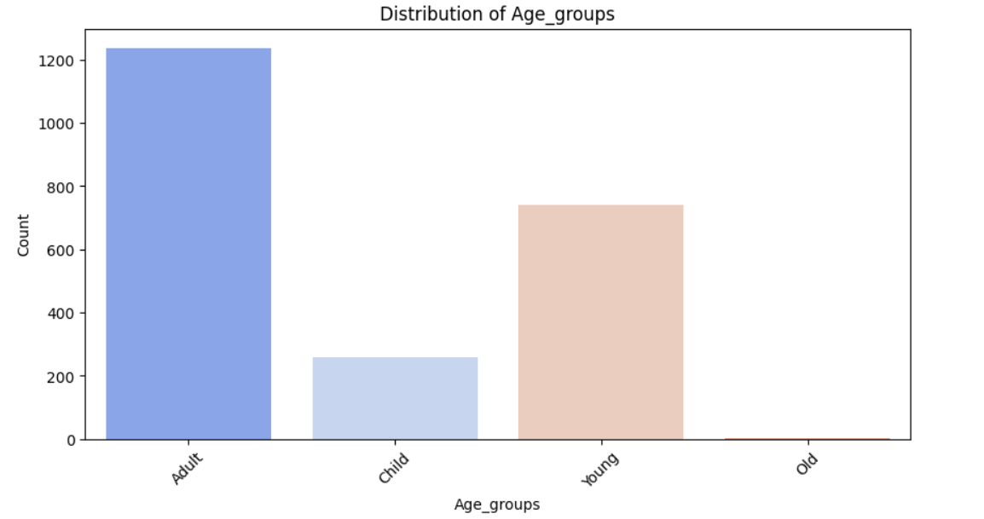
VISUALIZATIONS:
Bar chart:

Slide 7
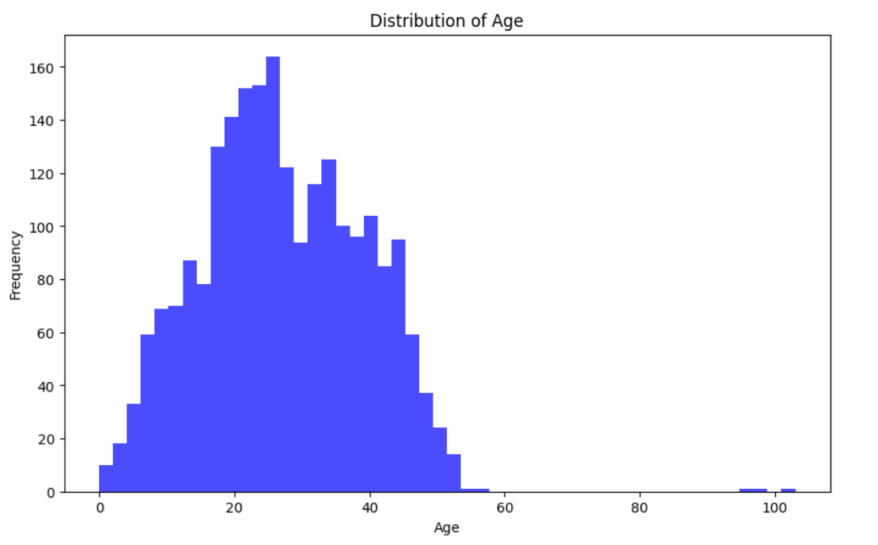
Histogram:

Slide 8
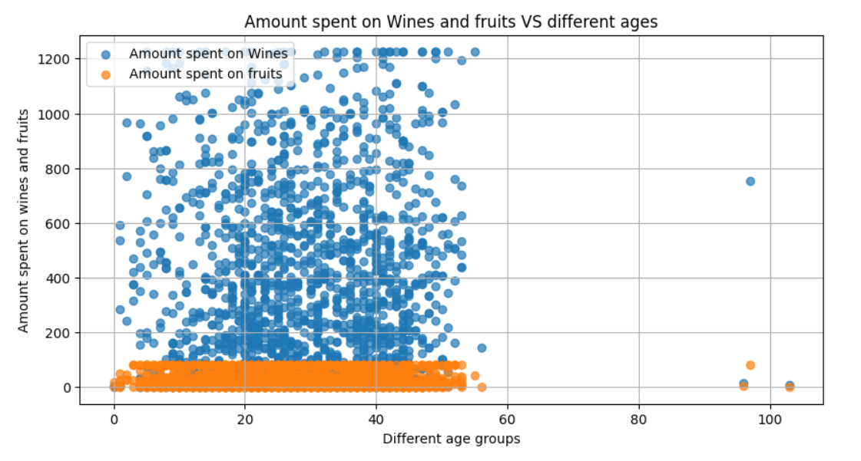
Scatterplot:

Slide 9
Insights :
Bar chart:
We have more than half (1200+) of customers (highest) are comes under `Adult` group and small of customers are in `Old` age group.
Histogram:
we have some right skewed data distribution.
due to most of customers are adults and that’s obvious.
Scatterplot:
In the above plot most of customer are between `1940` to `1998`.
And they are buying more wines than fruits.
So we can recommend them wines.

Slide 10
Model Building :
Choosing cleaned prepared dataset.
Split the data into training and testing set.
Building different models and train the model using training set.
Make prediction using test sets.
Evaluate the model performance.
Choosing best model by there training, testing score and minimum error.

Slide 11
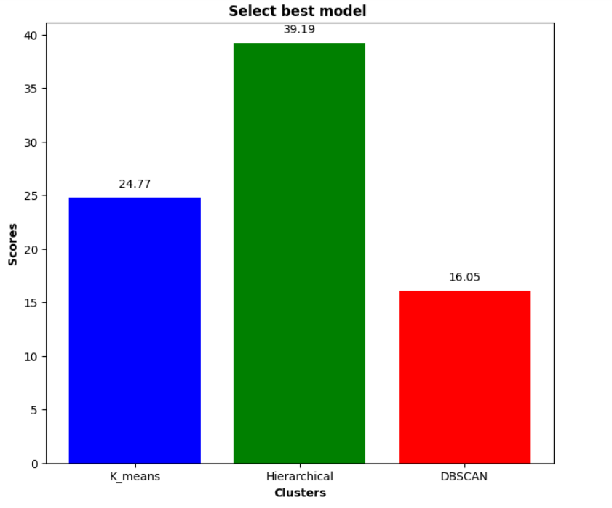
VISUALIZATION:

Slide 12
Observation :
Hierarchical cluster having highest score. - i.e. `39.19`.
Hierarchical clustering (specifically Agglomerative Clustering) builds nested clusters by progressively merging or splitting them.
It builds a hierarchy of clusters either from the bottom up (agglomerative) or the top down (divisive).
So we chose Hierarchical cluster for deployment.

Slide 13
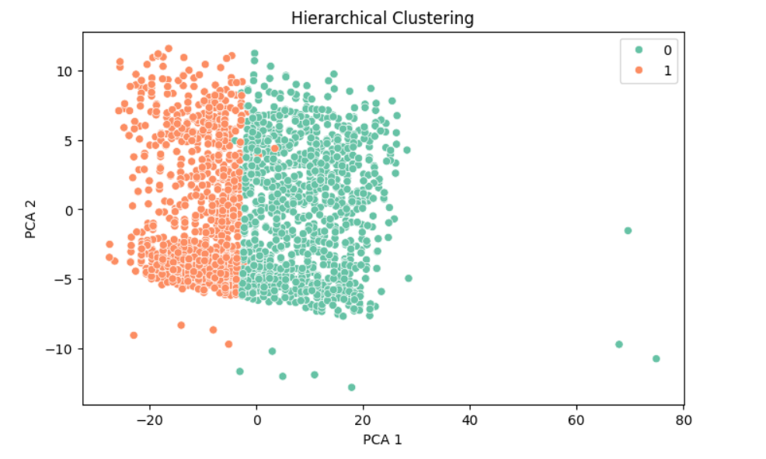
Cluster Visualization:

Slide 14
Model deployment :
Creating a ‘requirements.txt’ file having all necessary libraries names(Streamlit, pandas, numpy, scikit-learn).
All files(deployment code file, requirements.txt, pickle files) are pushed to GitHub copilot.
Then link to the streamlit cloud with same GitHub repository for the deployment.
Deployed app link:
https://customersegmentation-gbmjaw9nbh2y9jvgrhed6f.streamlit.app

Slide 15
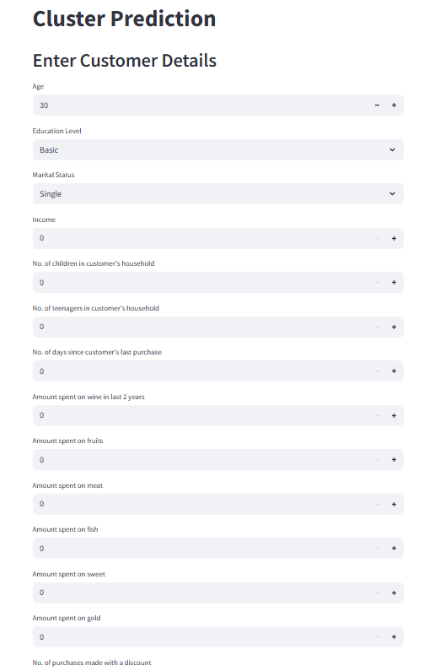
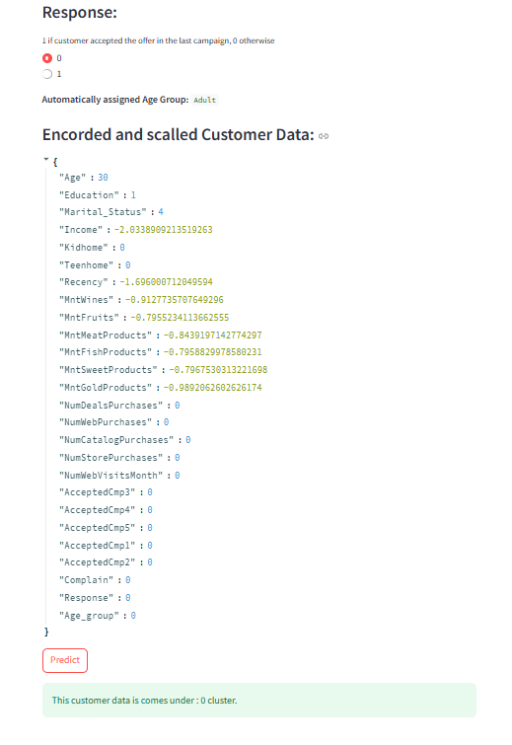
App preview :

Slide 16
Conclusion :
Key Takeaways:
We performed Exploratory Data Analysis (EDA) to understand customer behavior and identify patterns.
Applied Hierarchical Clustering and other modeling techniques to group customers into meaningful clusters.
Built a Logistic Regression model to predict the customer’s cluster based on user input.
Developed an interactive Streamlit application to make predictions and visualize cluster assignment.
Business Impact:
Enables businesses to target the right customers with the right offers.
Reduces marketing cost by avoiding blanket campaigns.
Supports personalized marketing, improving customer engagement and retention.
Provides deep insight into customer preferences and behaviors for strategic decision-making.

Slide 17
Thank you

